Slide 1
I can do things you cannot, you can do things I cannot; together we can do great things. – Mother Teresa
Lecture 15 – Merge Sort
CST370 – Design & Analysis of Algorithms
Dr. Byun
Computer Science

Slide 2
Lecture Objectives
After completion of this lecture, you will be able to
  use the divide-and-conquer technique to perform the merge sort.
  partition n numbers in an array into two groups with negative numbers and positive numbers.

Slide 3
Chapter 5: Divide-and-Conquer
5.1 Mergesort
5.2 Quicksort
5.3 Binary Tree Traversals and Related Properties
5.4 Multiplication of Large Integers and Strassen’s Matrix Multiplication
5.5 The Closest-Pair and Convex-Hull Problems by Divide-and-Conquer

Slide 4
Question – Merging Two Sorted Arrays
Assume that you have two sorted arrays like below
  1st array: 23, 47, 50, 81, 95
  2nd array: 7, 14, 39, 56, 62, 74
How will you merge them to create a sorted array?
  Result: 7, 14, 23, 39, 47, 50, 6, 62, 74, 81, 95

Slide 5
Merging Two Sorted Arrays
To get the basic idea of merging two sorted arrays, watch this video from the beginning to 2:34.
  http://y2u.be/GCae1WNvnZM
  Note that the video also present the basic idea of merge sort.

Slide 6
Merge Sort – Basic Idea
Watch this video from the beginning to 3:36.
  https://youtu.be/WMaH0-G4G4A
Merge sort uses the divide and conquer technique.
  Split an array A[0..n-1] into two halves and make copies of each half to the arrays B and C.
  Sort the arrays B and C recursively.
  Merge B and C into A.

Slide 7
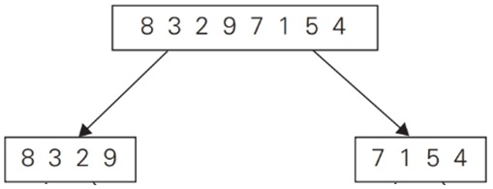
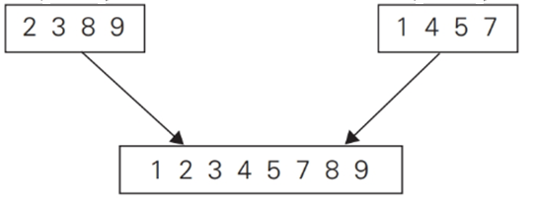
Merge Sort – Example (1 of 2)
Solve the first subproblem recursively.
Solve the second subproblem recursively.

Slide 8
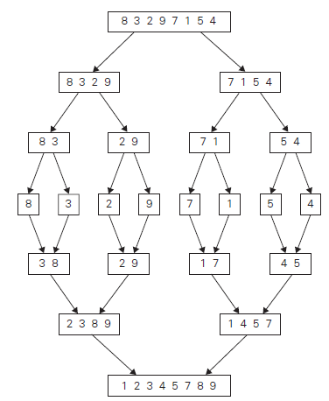
Merge Sort – Example (2 of 2)

Slide 9
Analysis of Merge Sort (1 of 2)
Merge sort uses the divide and conquer technique.
  So, let’s apply Master Theorem for the time efficiency.
What are the values of a, b, and d?
  Split an array A[0..n-1] into two halves and make copies of each half to the arrays B and C.
  Sort the arrays B and C recursively.
  Merge B and C into A.

Slide 10
Analysis of Merge Sort (2 of 2)

Slide 11
Question
Present a divide and conquer algorithm to find the index of the largest number in an array of n numbers.

Slide 12
Puzzle: Partition Numbers
Suppose you have an array with n numbers with negative and positive numbers mixed.
  Present an idea of putting all negative numbers in front of the positive numbers in the array.
Example
  Input: 8, -7, -4, 5, 4, -3, 9, 1, -5, -1
  Output: -7, -4, -1, -5, -3, 9, 1, 8, 5, 4
  // The output in the example is one possible result of
  // many other possibilities.
  // The important thing is that all negative numbers
  // must come first, and then all positive numbers
  // should follow them.

Slide 13
Solution

